Slide 1
CHEM 202TH
SECTION B
GROUP 15 (PART II)

Slide 2
Topics covered
Oxides of Nitrogen
Oxo acids of Nitrogen
Oxides of Phosphorus
Oxo acids of Phosphorus

Slide 3
Oxides of Nitrogen
N₂O Colourless gas
NO Colourless gas
N₂O₃ Blue solid
NO₂ Brown gas
N₂O₄ Colourless liquid
N₂O₅ Colourless gas
Q. Find the O.S of Nitrogen in above oxides?

Slide 4
Preparation of Oxides of Nitrogen
N₂O (Dinitrogen monoxide) Laughing gas
NH₄NO₃ 280 N₂O + 2H₂O
HNO₂ + N₃H N₂O +N₂ + H₂O
NO (Nitrogen monoxide)
3Cu + 8HNO₃(dil) 3Cu(NO₃)₂ + 4H₂O + 2NO
2KNO₂ + 2KI +2H₂SO₄ 2K₂SO₄ + 2NO +I₂+2H₂O

Slide 5
Preparation
N₂O₃ :Mixing equimolar quantities of NO and NO₂ and cooling below -25 C
NO+ NO₂ -25 N₂O₃(Blue Liquid)
6HNO₃ + 2Cu Cu(NO₃)₂ + N₂O₃ +3H₂O(LAB )
NO₂ :
Pb(NO₃)₂ PbO +NO₂ + O₂
Cu +4HNO₃(conc) Cu(NO₃)₂ +2NO₂+2H₂O
N₂O₃ +2HNO₃(fuming) 2N₂O₄ + H₂O

Slide 6
Preparation
N₂O₅
1). Prepared by distilling concentrated nitric acid over P₂O₅
2HNO₃ + P₂O₅ N₂O₅ + 2HPO₃
2) Passing ozone through liq NO₂
N₂O₄ + O₃ N₂O₅ + O₂

Slide 7
PROPERTIES (N₂O and N₂O₃)
N₂O
N₂O₃
N₂O
It is stable and does not react with water
It oxidises some metals and non metals.
P₄ + 10N₂O P₄O₁₀ + 10N₂
Cu + N₂O CuO + N₂
Used for whipped icecream and as an anaesthetic by dentists for minor operations.
N₂O₃
It is acid anhydride of nitrous acid.
2HNO₂ N₂O₃ + H₂O
Obtained from reduction of Nitric acid
Cu + 6HNO₃ Cu(NO₃)₂+N₂O₃ + 3H₂O
It is intensely blue liquid and pale blue solid.
With acids :N2O3 +H2SO4 2NO.HSO4 +H2O
With base :N2O3+KOH KNO2 +H2O

Slide 8
NITROGEN MONOXIDE (PROPERTIES)
1)It is most stable of all oxides of nitrogen
2)It supports combustion of S and P
S₈ + 16 NO 8SO₂ +8N₂
3)It gives brown fumes WITH O₂
2NO + O₂ 2NO₂
4)Acts as reducing agent
6KMnO₄+9H₂SO₄+ 10NO K₂SO₄ + MnSO₄ + H₂O +HNO₃
5)Acts as oxidising agent : 2Cu + 2NO 2CuO + N₂
6) With halogens gives nitrosyl halides: 2NO+X₂ 2NOX
7)Formation of complex: FeSO₄ + NO + 5H₂O [Fe(H₂O)5NO]SO₄ This complex is responsible for the brown ring in the RING TEST FOR NITRATES(QUALITATIVE ANALYSIS)
8)With metal hydroxides
2KOH + 6NO KNO₂ + N₂ + 2H₂O

Slide 9
Properties NO2
It exists in two forms in equilibrium
N2O4 (colourless) 2NO2 (Brown)
It is mixed anhydride of nitrous and nitric acid.
With alkali solution gives both nitrite and nitrate
2NaOH +2NO2 NaNO2 + NaNO3 + H2O
With warm water only nitric acid
3HNO2 HNO3 +H2O +2NO
Strong oxidising agent
NO2 +H2S H2O +NO+S
2KI +NO2 2KNO2 +I2
With H2SO4: 2NO2 + H2SO4 NO.HSO4 +HNO3
With metals salts : NaCl + NO2 NaNO3 + NOCl

Slide 10
N₂O₅ Properties
It is anhydride of nitric acid
N₂O₅ +H₂O 2HNO₃
With alkalies: N₂O₅ +2NaOH 2NaNO₃ +H₂O
Powerful oxidising agent ,destroys organic matter C +2N₂O₅ CO₂ +4NO₂
On heating :2N₂O₅ 4NO₂ +O₂

Slide 11
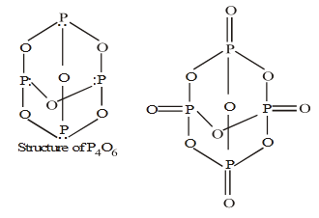
Oxides of Phosphorus
P₄O₆
P₄O₈
P₄O₁₀

Slide 12
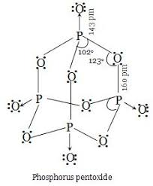
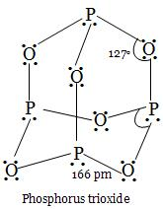
Structure oxides of phosphorus

Slide 13
Preparation (Oxides of Phosphorus)
P₄O₆ :Burning white phosphorus in limited air
P₄ + 3O₂ P₄O₆
P₄O₈ : Heating P₄O₆ in a sealed tube
4P₄O₆ 440 C 3P₄O₈ +P₄
P₄O₁₀ :Burning white phosphorus in excess of air.
P₄ + 5O₂ P₄O₁₀

Slide 14
Properties of Oxides of Phosphorus
P₄O₆ +2O₂ P₄O₁₀
P₄O₆ +6H₂O (COLD ) 4H₃PO₃
P₄O₆ + 6H₂O (HOT) 3H₃PO₄ +PH₃
WRITE THE REACTION OF P4O8 WITH WATER
HOW MANY P-O-P BONDS ARE THERE IN P4O8
It shows phosphorescence .It is acidic ,turns blue litmus red
With cold H2O : P2O5+H2O 2HPO3
With hot water: P2O5 + 3H2O 2H3PO4
It is a good dehydrating agent : C12H22O11 +P2O5 12C +22HPO3
Reduced to red P BY CARBON

Slide 15
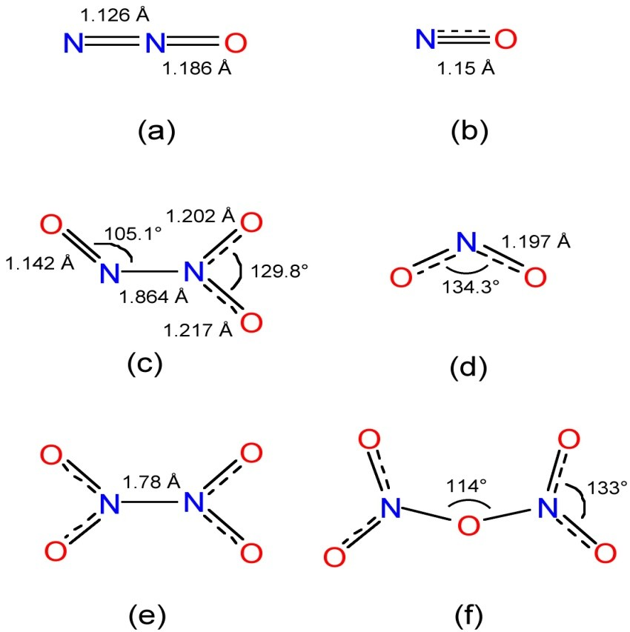
STRUCTURE OF OXIDES OF N

Slide 16
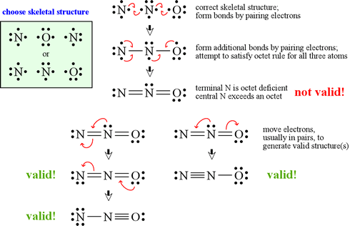
How to draw right Lewis structure

Slide 17
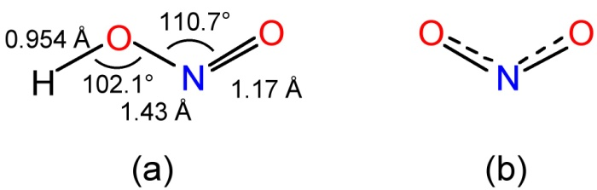
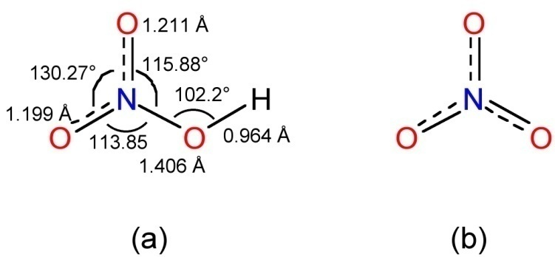
Oxoacids of N & P
NITROGEN
PHOSPHORUS
H₂N₂O₂ Hyponitrous acid
HNO₂ Nitrous acid
HNO₃ Nitric acid
H₃PO₂ Hypophosphorus acid
H₃PO₃ Phosphorus acid
H₄P₂O₆ Hypophosphoric acid
H₃PO₄ Orthophosphoric acid
H₄P₂O₇ Diphosphoric acid
HPO₃ Metaphosphoric acid

Slide 18
Preparation of oxoacids
Nitrogen
PHOSPHORUS
1)H₂N₂O₂ from NH₂OH
NH₂OH +HNO₂ H₂N₂O₂+H2O
2)HNO₂ from N₂O₃
N₂O₃ +H₂O 2HNO₂
3)HNO₃ from OSTWALDS METHOD
NH₃ gives NO with air,which is oxidised to NO₂ & NO₂ with water gives HNO₃ .
1)H₃PO₂:
PH3+I2 +2H2O H₃PO₂+4HI
2)H₃PO₃:
P2O5 +H2O 2H₃PO₃
3)H₄P₂O₆:
Pb₂P₂O₆ +2H₂S PbS+H₄P₂O₆
4)H3PO4:
P₄O₁₀ + 6H₂O H₃PO₄
5)H₄P₂O₇:
2H₃PO₄ H₄P₂O₇ +H₂O
6) HPO3:
P₄O₁₀+2H₂O 4HPO₃

Slide 19
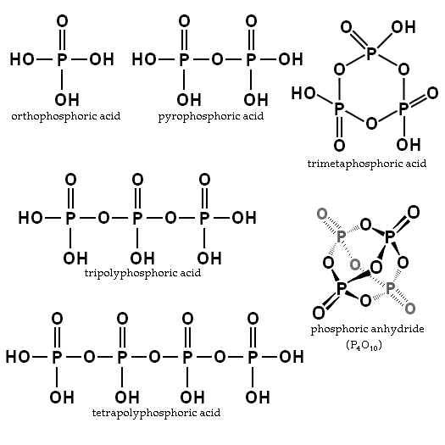
STRUCTURE OF OXOACIDS OF P

Slide 20
PROPERTIES OF OXOACIDS OF PHOSPHORUS
H3PO3 IS AREDUCING AS WELL AS OXIDISING AGENT BUT H3PO4 IS NOT A REDUCING AGENT?
Phosphorus in H3PO3 has +3 O.S ,which in this reaction increases to+5 (oxidation) and decreases to -3 (reduction).So it acts as both oxidising and reducing agent.
H3PO4 ,O.S of P is +5 which cannot be increased further, so does not show oxidation and does not act as reducing agent.

Slide 21
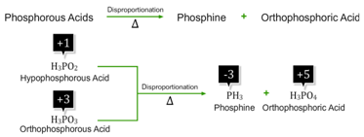
Disproportionation /Self Redox in Oxoacids
H₃PO₃ in this reaction shows an increase in O.S of phosphorus from +3 to+5 so oxidation.
In the same reaction IT SHOWS A DECREASE IN O.S of Phosphorus from +3 to -3,so reduction.
So H₃PO₃ acts as Oxidising and reducing agent both.

Slide 22
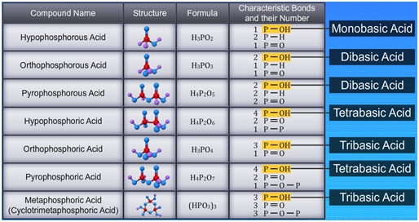
Understanding basicity from structure
H₃PO₃ is dibasic Acid Comment

Slide 23
Some basic questions
What is the difference between white and red phosphorus?
Which oxide of phosphorus is a good dehydrating agent?
What is Ring test of nitrates?
What is Ostwald's Process ,where is it used?
Show that H3PO4 is tribasic.
How many ionizable P-OH bonds are present in H3PO3?
Next topic: Interhalogens

